Slide 1

Student Details:
Name: Adam Idris
Skillsbuild id: adamidrisadam004@gmail.com
College Name: SRM AP
College State: Andhra Pradesh
Internship Domain: Data Analysis
Internship Date: 3rd June 2024 – 25 July 2024

Slide 2
Analysis of Car Sales Data to Determine Factors Affecting Depreciation and Market Trends
Problem Statement
The goal of this project is to analyse car sales data to uncover insights regarding vehicle depreciation, market trends, and factors affecting the resale value of cars.
The project aims to provide valuable information for potential car buyers, sellers, and dealers.

Slide 3
AGENDA
Introduction to the project and its objectives
Data Collection from Kaggle
Data exploration and understanding
Data cleaning and preparation
Descriptive statistics and initial observations
Analysis of vehicle depreciation
Identification of factors affecting selling prices
Visualization of key findings
Insights and recommendations
Conclusion

Slide 4
PROJECT OVERVIEW
This project involves examining a dataset of car sales to identify the patterns and factors that impact car depreciation and resale value.
The dataset includes details such as the car's name, manufacturing year, selling price, current price, kilometers driven, fuel type, seller type, transmission, and ownership history.
The analysis explores various aspects, including the age of the vehicles, prices, ownership history, and the factors influencing depreciation. Key trends and findings are highlighted using visualizations.

Slide 5
WHO ARE THE END USERS of this project?
The end users of this project include:
Car buyers: People interested in purchasing used cars can utilize the insights to make well-informed decisions.
Car sellers: Individuals or dealerships selling used cars can better understand market trends and set appropriate prices for their vehicles.
Car dealers: Dealerships can enhance their inventory management and pricing strategies based on the analysis results.
Market analysts: Analysts focusing on the automobile market can leverage the insights for research and reporting purposes.

Slide 6
YOUR SOLUTION AND ITS VALUE PROPOSITION
Solution: The project offers an in-depth analysis of car sales data, highlighting the primary factors that influence car depreciation and resale value. By examining historical sales data, the project reveals trends and patterns that aid in making informed decisions about car buying and selling.
Value Proposition:
For buyers: The analysis assists buyers in identifying cars that retain their value better over time, potentially saving money by avoiding vehicles with high depreciation.
For sellers: Sellers can set more competitive and realistic prices, resulting in faster sales and higher returns.
For dealers: Dealers can enhance their inventory management and pricing strategies to maximize profits and increase turnover rates.

Slide 7
How did you customize the project and make it your own
Customization involved:
Adding a depreciation column: This column calculates the difference between the current price and the selling price, providing a direct measure of depreciation.
Identifying least and most depreciated vehicles: The analysis identifies brands and models that depreciate the least and most, offering insights into which vehicles retain their value.
Correlation analysis: This analysis determines factors (such as year of manufacture and kilometers driven) that correlate with depreciation and selling price.
Filtering data: Specific analyses were performed on subsets of data, including newer vehicles (manufactured after 2014) and two-wheelers.
Visualization: Custom plots and charts were created to visualize the findings, making the insights more accessible and easier to understand.

Slide 8
MODELLING
The project concentrated on exploratory data analysis (EDA) and statistical analysis rather than predictive modeling. Key steps included:
Descriptive statistics: Summarizing the main features of the data.
Correlation analysis: Identifying relationships between variables (e.g., depreciation and kilometers driven).
Group by operations: Analyzing average depreciation by car brand and model.
Visualization: Creating visual representations of the data using matplotlib and seaborn.

Slide 9
Results
Manufacturing Year Range: Vehicles in the dataset were produced between 2003 and 2018.
Price Range: Selling prices varied from 0.1 to 35.0.
Most Sold Vehicle: The most frequently sold model was the 'city.'
Fuel Types: The dataset included petrol, diesel, and CNG vehicles, with petrol being the most prevalent.
Seller Types: Vehicles were sold by both dealers and individuals, with the majority sold by dealers.
Transmission Types: Most vehicles had manual transmission.
Depreciation: The analysis identified the least depreciated vehicle as the TVS Sport and the most depreciated vehicle as the Land Cruiser.
Factors Affecting Depreciation: Year of manufacture and kilometers driven were found to correlate with depreciation.
High-Value Deals: The analysis highlighted vehicles sold above the average price, offering insights into high-value deals.
Common Fuel Type: Petrol was the most common fuel type.
Mileage Distribution: The average kilometers driven for vehicles in the dataset was approximately 36,947.

Slide 10
links
https://github.com/adermgram/edunet-data-analysis.git

Slide 11
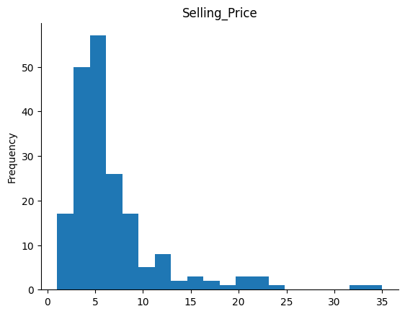
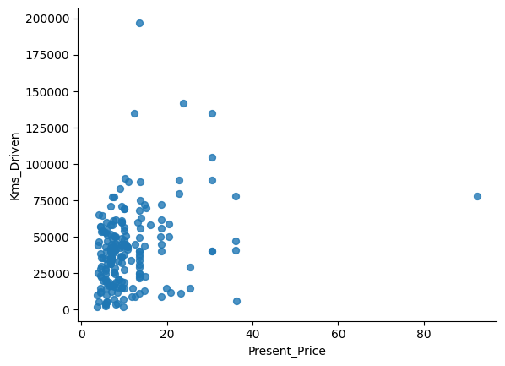
Visualization Part 1
Present Price vs Kms Driver

Slide 12
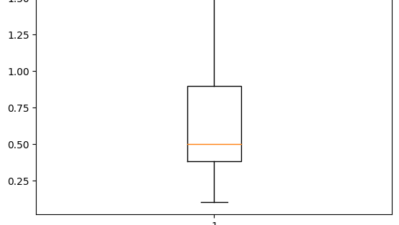
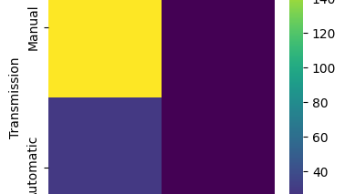
Visualisation Part 2
Box plot under the expectation
Seller_Type vs Transmission

Slide 13
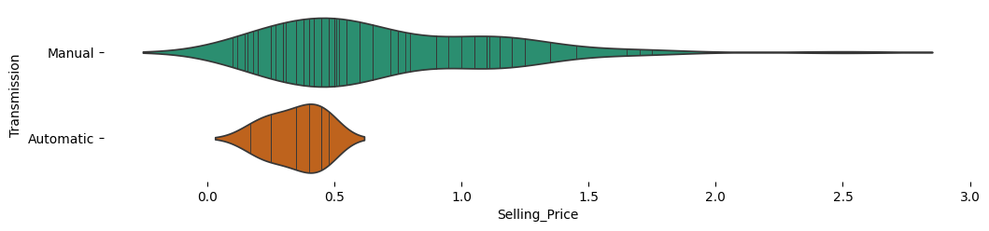
Transmission vs Selling Price

Slide 14
Thank you

